Slide 1
Internet of Things CC3200 wifi_Launchpad Tutorial REKAM1-Rapid Prototyping Guang Zhou
http://energia.nu/cc3200guide/
http://energia.nu/download/
https://github.com/gzhou358/CS6308-Realtime-system

Slide 2

Project description
Door
Bluetooth Device
Mobile Device

Slide 3

Project description
BT#4
BT#2
Sort of signal strength:
BT#1
BT#3
BT#2
BT#4
Door
BT#3
BT#1

Slide 4
Project description
BT#4
BT#2
Sort of signal strength:
BT#4
BT#3
BT#2
BT#1
Door
BT#3
BT#1

Slide 5
Project description
BT#4
BT#2
BT#3
The mobile device has to
communicate with the launch
pad and open the door.
BT#1

Slide 6
What is needed
Mobile device/Smart phone.
Knowledge on mobile application development.
Bluetooth device and launch board will be provided.

Slide 7
Android development
Tutorial on Android Developer:
http://developer.android.com/training/index.html

Slide 8
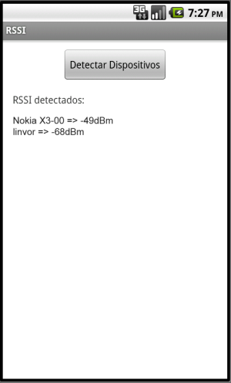
Bluetooth App
An Android App used to discover Bluetooth device
and get the signal strength.
“RSSIActivity.java”
Reference:
http://stackoverflow.com/questions/15312858/get-bluetooth-signal-strength
http://developer.android.com/reference/android/bluetooth/package-summary.html

Slide 9

Why?
FAST and EASY
No Tools/Manuals
Text code from your phone(wireless)
Small
Size
Cost
Energy
100% Arduino Compatible
Energia
Open Source

Slide 10
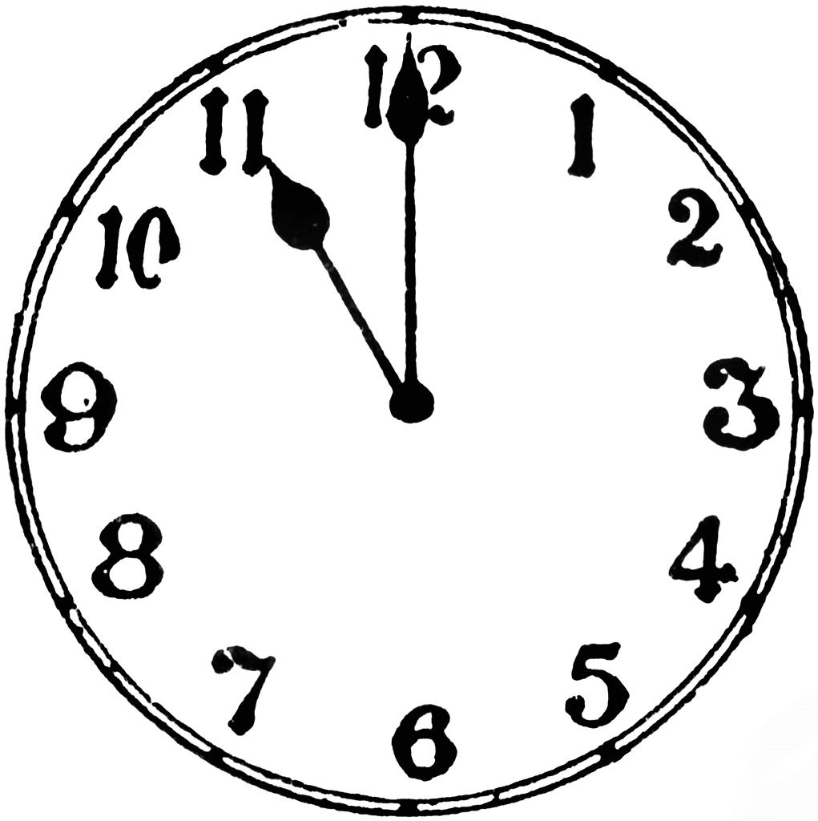
What?
REKAM1
Mobile Device/PC
Interpreter
(Serial ISR)
Application or
Terminal Emulator
Virtual State Machine
(Input ISR)
(BT/BLE/UART)
Remote
Procedure
Calls/Data
(BT/
BLE)
(Wi-Fi/
Cloud)
(XML/
JSON)
Other
Bluetooth Devices
Other
Connected Devices
Virtual
State
Machine
Time To
Prototype
Virtual
Machine(Android)
RTOS Embedded
System(C Compiler)

Slide 11
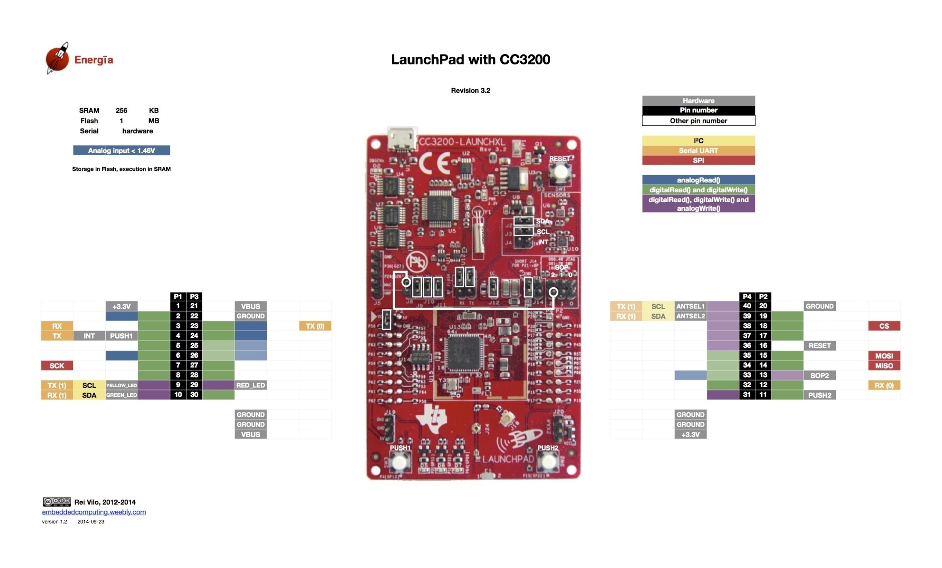
Hardware_CC3200 wifi LaunchPad

Slide 12
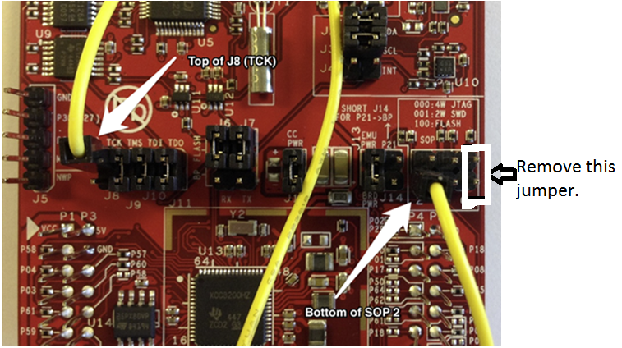
Jumper Setting

Slide 13
Software Installation
download energia from website.
http://energia.nu/download/
Choose the latest version for your operation system.
No driver needs.

Slide 14
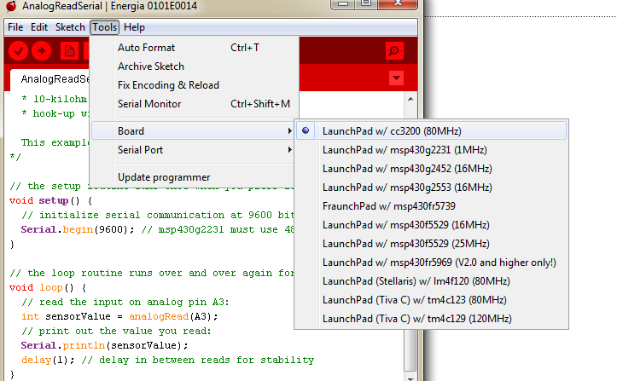
Board Setup1

Slide 15
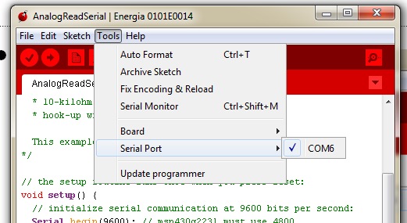
Board Setup2
There should be only 1 port and choose that one.

Slide 16
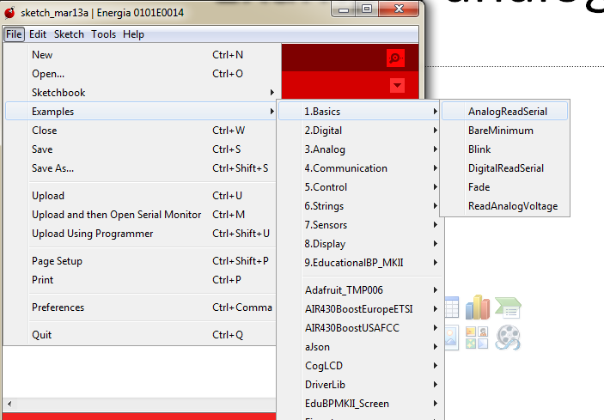
Example analog read

Slide 17
Example analog read
// the setup routine runs once when you press reset:
void setup() {
// initialize serial communication at 9600 bits per second:
Serial.begin(9600); // msp430g2231 must use 4800
}
// the loop routine runs over and over again forever:
void loop() {
// read the input on analog pin A3:
int sensorValue = analogRead(A3);
// print out the value you read:
Serial.println(sensorValue);
delay(1); // delay in between reads for stability (miliseconds)
}

Slide 18
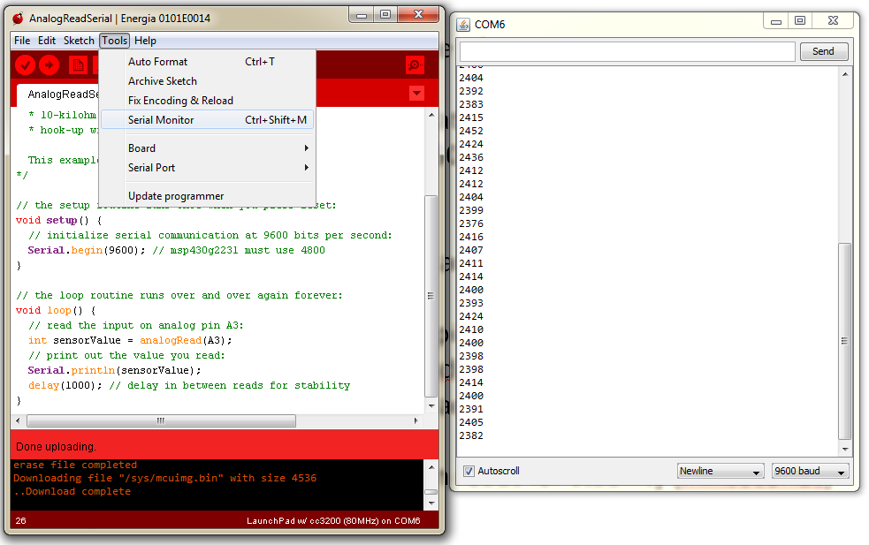
Example analog read
Open Serial Monitor to see results

Slide 19
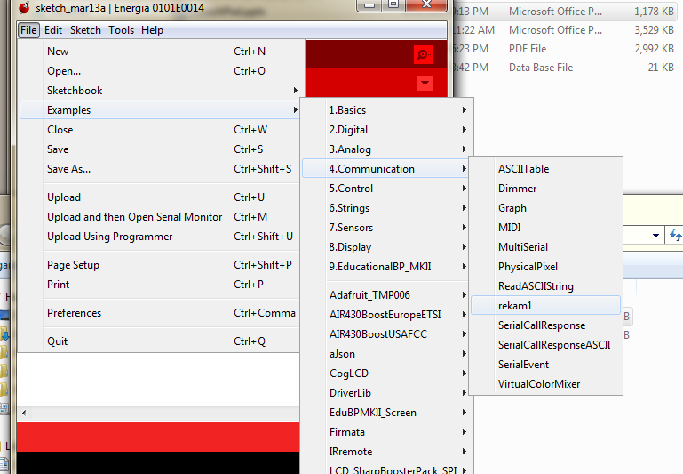
Example rekam1

Slide 20
Or use the reduced version
#ifdef CCx
char ssid[] = "asd123"; // your network SSID (name)
char pass[] = "12345678"; // your network password
uint16_t port = 1200; // port number of the server
IPAddress server(192, 168, 10, 102); // IP Address of the server
WiFiClient client;
int status = WL_IDLE_STATUS; // the Wifi radio's status
#endif
void setup() {
//Initialize serial and wait for port to open:
Serial.begin(9600);
// These Pin Modes are specific to each Launchpad and can be reconfigured here. To Use a different Launchpad/Uncomment Relevant Code here and in get/put functions
pinMode(2, INPUT); //analogread
pinMode(3, INPUT); //digitalread
pinMode(5, INPUT); //digitalread
pinMode(6, INPUT); //analogread
pinMode(7, OUTPUT); //digitalwrite
pinMode(8, OUTPUT); //digitalwrite
pinMode(9, OUTPUT); //analogwrite
pinMode(10, OUTPUT); //analogwrite

Slide 21
Or use the reduced version
int get(int pin){
//Read multi time to get correct data.
if ((pin==2)||(pin==6)){ // you can change the pin setting.
analogRead(pin);
analogRead(pin);
analogRead(pin);
analogRead(pin);
analogRead(pin);
value = analogRead(pin);
Serial.print("analogRead ");
Serial.println(value);
return value;
}
else if ((pin==3)||(pin==5)){ // you can change the pin setting.
digitalRead(pin);
digitalRead(pin);
digitalRead(pin);
digitalRead(pin);
digitalRead(pin);
value = digitalRead(pin);
Serial.print("digitalRead ");
Serial.println(value);
return value;
}
else {
Serial.println("choose correct pin");
return -1;
}
}

Slide 22
Or use the reduced version
// Puts an analog or digital value on a pin from 0 100 percent of VCC
int put(int pin, int value){
if(value<0){value=0;}
if ((pin==9)||(pin==10)){
analogWrite(pin,value);
Serial.print("analogWrite ");
Serial.println(value);
return value;
}
else if ((pin==7)||(pin==8)){
digitalWrite(pin,value);
Serial.print("digitalWrite ");
Serial.println(value);
return value;
}
else {
Serial.println("choose correct pin");
return -1;
}
}

Slide 23
Chat between pc and IoT board code
import java.net.*;
import java.io.*;
import java.util.Scanner;
public class CC3200_Controller{
private static Socket socket;
public static void main(String[] args) {
try{
int port = 1200;
ServerSocket serverSocket = new ServerSocket(port);
System.out.println("Server Started and listening to the port 1200");
while(true){
socket = serverSocket.accept();
System.out.println("Clinet connected to the server");
InputStream is = socket.getInputStream();
InputStreamReader isr = new InputStreamReader(is);
BufferedReader br = new BufferedReader(isr);
OutputStream os = socket.getOutputStream();
OutputStreamWriter osw = new OutputStreamWriter(os);
BufferedWriter bw = new BufferedWriter(osw);
String rmessage;
String smessage;
Scanner s = new Scanner(System.in);
while(true){
smessage = s.nextLine();
bw.write(smessage);
bw.flush();
rmessage = br.readLine();
System.out.println(rmessage);
}
}
}catch (Exception e){
e.printStackTrace();
}finally
{
try{
socket.close();
}
catch(Exception e){
}
}
}
}

